Slide 1

PARALLEL DATABASES
By: Dr. Devpriya Soni
Department of Computer Science and Engineering & IT
Jaypee Institute of Information Technology, Noida
Notes:
Frequently, presenters must deliver material of a technical nature to an audience unfamiliar with the topic or vocabulary. The material may be complex or heavy with detail. To present technical material effectively, use the following guidelines from Dale Carnegie Training®.
Consider the amount of time available and prepare to organize your material. Narrow your topic. Divide your presentation into clear segments. Follow a logical progression. Maintain your focus throughout. Close the presentation with a summary, repetition of the key steps, or a logical conclusion.
Keep your audience in mind at all times. For example, be sure data is clear and information is relevant. Keep the level of detail and vocabulary appropriate for the audience. Use visuals to support key points or steps. Keep alert to the needs of your listeners, and you will have a more receptive audience.

Slide 2
Lecture will cover following points
Introduction
I/O Parallelism
Interquery Parallelism
Intraquery Parallelism
Intraoperation Parallelism
Interoperation Parallelism
Design of Parallel Systems

Slide 3
Goal of Database Management System
Provides a way to store and retrieve information
Uses convenient and efficient way
Management of data involves
Defining structure for storage of information
Providing mechanism for manipulation of information

Slide 4
Introduction
Databases are growing increasingly large
large volumes of transaction data are collected and stored for later analysis.
multimedia objects like images are increasingly stored in databases

Slide 5
Need of Parallelism
Parallel machines are becoming quite common and affordable
Prices of microprocessors, memory and disks have dropped sharply
Recent desktop computers feature multiple processors and this trend is projected to accelerate

Slide 6
Goal of Parallelism
Large-scale parallel database systems increasingly used for:
storing large volumes of data
processing time-consuming decision-support queries
providing high throughput for transaction processing
With all these we are moving towards performance improvement

Slide 7
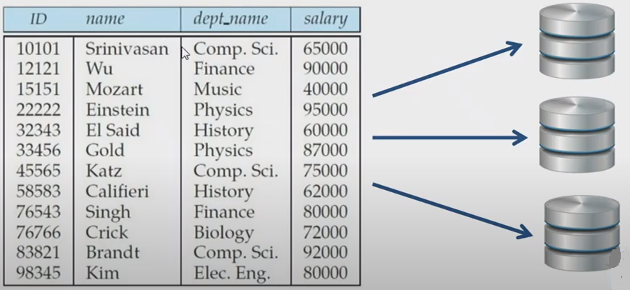
Parallelism in Databases
Data can be partitioned across multiple disks for parallel I/O.

Slide 8
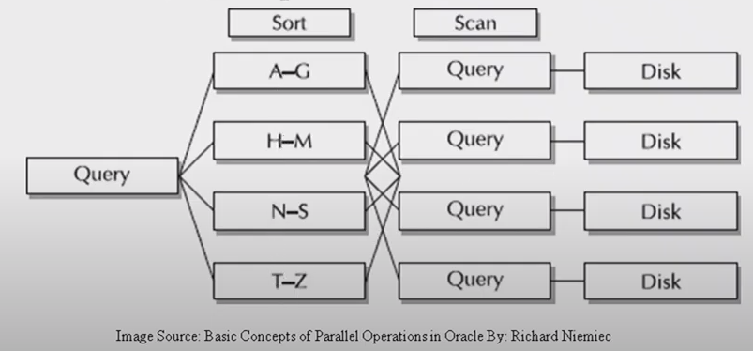
Individual relational operations (e.g., sort, join, aggregation) can be executed in parallel

Slide 9
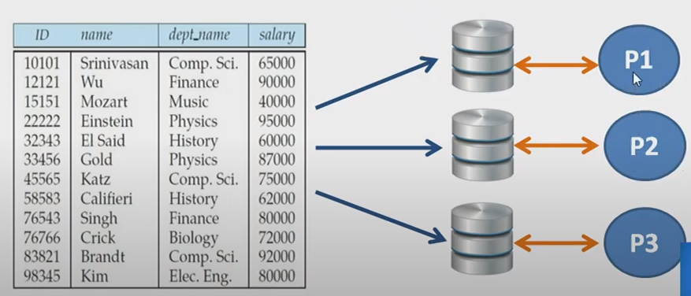
data can be partitioned and each processor can work independently on its own partition.

Slide 10
I/O Parallelism
Reduce the time required to retrieve relations from disk by partitioning
The relations on multiple disks.
Horizontal partitioning – tuples of a relation are divided among many disks such that each tuple resides on one disk.

Slide 11
Queries are expressed in high level language (SQL, translated to relational algebra)
makes parallelization easier.
Different queries can run in parallel with each other.
Concurrency control takes care of conflicts.
Thus, databases naturally lend themselves to parallelism.

Slide 12
Partitioning techniques
Partitioning techniques (number of disks = n):
Round-robin:
Send the I th tuple inserted in the relation to disk i mod n.
Hash partitioning:
Choose one or more attributes as the partitioning attributes.
Choose hash function h with range 0…n - 1
Let i denote result of hash function h applied to the partitioning attribute value of a tuple. Send tuple to disk i.
Range partitioning:
Choose an attribute as the partitioning attribute.
A partitioning vector [vo, v1, ..., vn-2] is chosen.
Let v be the partitioning attribute value of a tuple. Tuples such that vi ≤ vi+1 go to disk I + 1. Tuples with v < v0 go to disk 0 and tuples with v ≥ vn-2 go to disk n-1.
E.g., with a partitioning vector [5,11], a tuple with partitioning attribute value of 2 will go to disk 0, a tuple with value 8 will go to disk 1, while a tuple with value 20 will go to disk2.
Content Sources: -Elamsari and Navathe, Fundamentals of Database Management systems, -Silberschatz−Korth−Sudarshan • Database System Concepts, Fourth Edition

Slide 13
Comparison of Partitioning Techniques
Content Sources: -Elamsari and Navathe, Fundamentals of Database Management systems, -Silberschatz−Korth−Sudarshan • Database System Concepts, Fourth Edition
Evaluate how well partitioning techniques support the following types of data access:
1. Scanning the entire relation.
2. Locating a tuple associatively – point queries.
E.g., r.A = 25.
3. Locating all tuples such that the value of a given attribute lies within a specified range – range queries.
E.g., 10 ≤ r.A < 25.

Slide 14
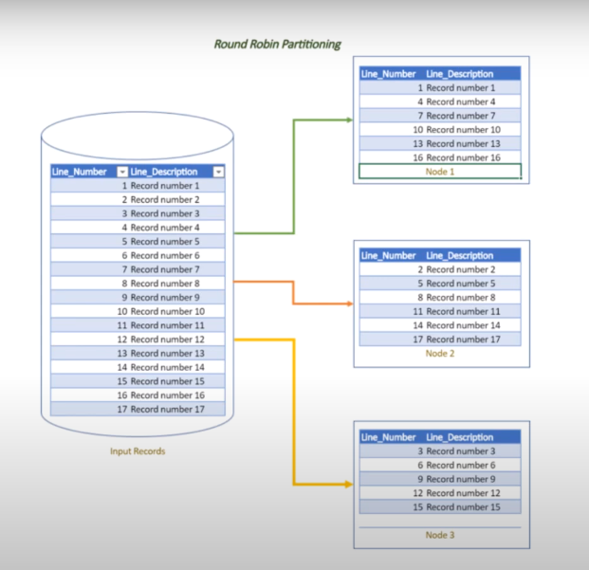
Comparison of Partitioning Techniques (Cont.)
Round robin:
Advantages
Best suited for sequential scan of entire relation on each query.
All disks have almost an equal number of tuples; retrieval work is thus well balanced between disks.
Range queries are difficult to process
No clustering -- tuples are scattered across all disks

Slide 15
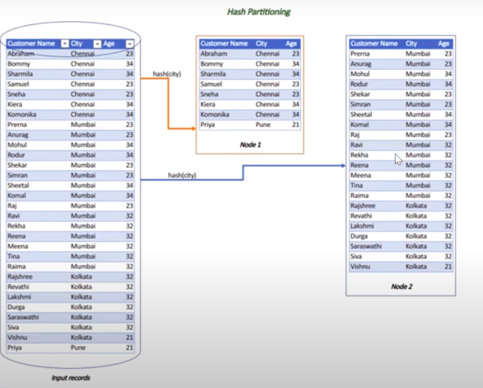
Comparison of Partitioning Techniques (Cont.)
Hash partitioning:
Good for sequential access
Assuming hash function is good, and partitioning attributes form a key, tuples will be equally distributed between disks
Retrieval work is then well balanced between disks.
Good for point queries on partitioning attribute
Can lookup single disk, leaving others available for answering other queries.
Index on partitioning attribute can be local to disk, making lookup and update more efficient
No clustering, so difficult to answer range queries

Slide 16
Comparison of Partitioning Techniques (Cont.)
Range partitioning:
Provides data clustering by partitioning attribute value.
Good for sequential access
Good for point queries on partitioning attribute: only one disk needs to be accessed.
For range queries on partitioning attribute, one to a few disks may need to be accessed
Remaining disks are available for other queries.
Good if result tuples are from one to a few blocks.
If many blocks are to be fetched, they are still fetched from one to a few disks, and potential parallelism in disk access is wasted
Example of execution skew.

Slide 17
Partitioning a Relation across Disks
If a relation contains only a few tuples which will fit into a single disk block, then assign the relation to a single disk.
Large relations are preferably partitioned across all the available disks.
If a relation consists of m disk blocks and there are n disks available in the system, then the relation should be allocated min(m,n) disks.

Slide 18
Handling of Skew
The distribution of tuples to disks may be skewed — that is, some disks have many tuples, while others may have fewer tuples.
Types of skew:
Attribute-value skew.
Some values appear in the partitioning attributes of many tuples; all the tuples with the same value for the partitioning attribute end up in the same partition.
Can occur with range-partitioning and hash-partitioning.
Partition skew.
With range-partitioning, badly chosen partition vector may assign too many tuples to some partitions and too few to others.
Less likely with hash-partitioning if a good hash-function is chosen.

Slide 19
Handling Skew in Range-Partitioning
To create a balanced partitioning vector (assuming partitioning attribute forms a key of the relation):
Sort the relation on the partitioning attribute.
Construct the partition vector by scanning the relation in sorted order as follows.
After every 1/n^{th} of the relation has been read, the value of the partitioning attribute of the next tuple is added to the partition vector.
n denotes the number of partitions to be constructed.
Duplicate entries or imbalances can result if duplicates are present in partitioning attributes.
Alternative technique based on histograms used in practice
Content Sources: -Elamsari and Navathe, Fundamentals of Database Management systems, -Silberschatz−Korth−Sudarshan • Database System Concepts, Fourth Edition

Slide 20
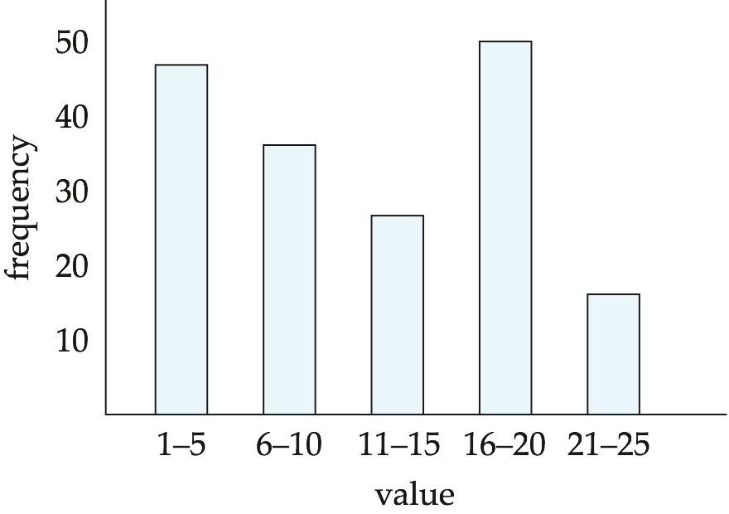
Handling Skew using Histograms
Balanced partitioning vector can be constructed from histogram in a relatively straightforward fashion
Assume uniform distribution within each range of the histogram
Histogram can be constructed by scanning relation, or sampling (blocks containing) tuples of the relation

Slide 21
Handling Skew Using Virtual Processor Partitioning
Skew in range partitioning can be handled elegantly using virtual processor partitioning:
create a large number of partitions (say 10 to 20 times the number of processors)
Assign virtual processors to partitions either in round-robin fashion or based on estimated cost of processing each virtual partition
Basic idea:
If any normal partition would have been skewed, it is very likely the skew is spread over a number of virtual partitions
Skewed virtual partitions get spread across a number of processors, so work gets distributed evenly!
Content Sources: -Elamsari and Navathe, Fundamentals of Database Management systems, -Silberschatz−Korth−Sudarshan • Database System Concepts, Fourth Edition

Slide 22
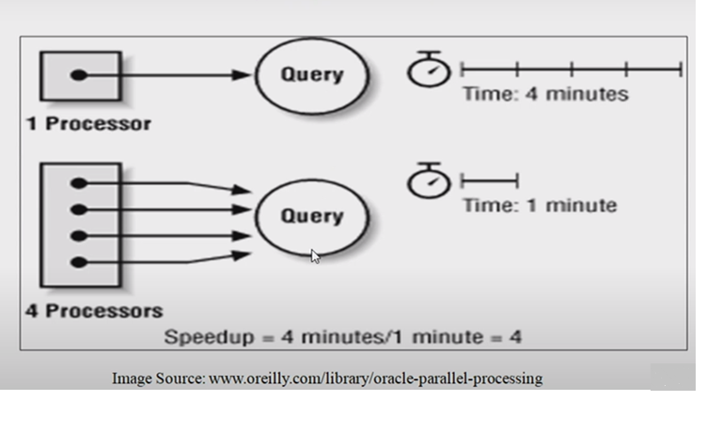
Query Parallelism
In parallel database system to improve the performance of the system parallelism is used
It is achieved through query parallelism
The transaction throughput is increased by parallel execution of one or more queries

Slide 23
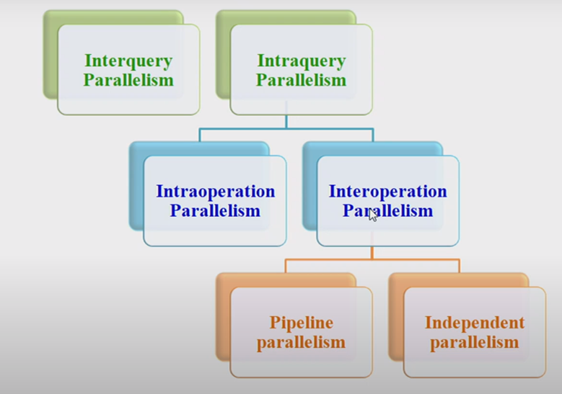
Types of query parallelism
Content Sources: WIT Solapur - Professional Learning Community

Slide 24
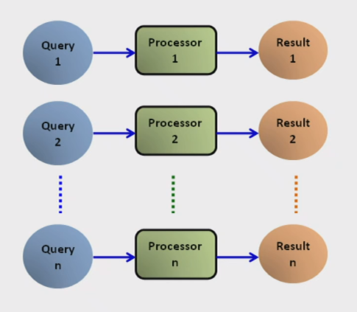
Interquery Parallelism
“Parallelism among queries”
Different queries or transactions are executed in parallel with one another
Main aim: scaling up transaction processing systems

Slide 25
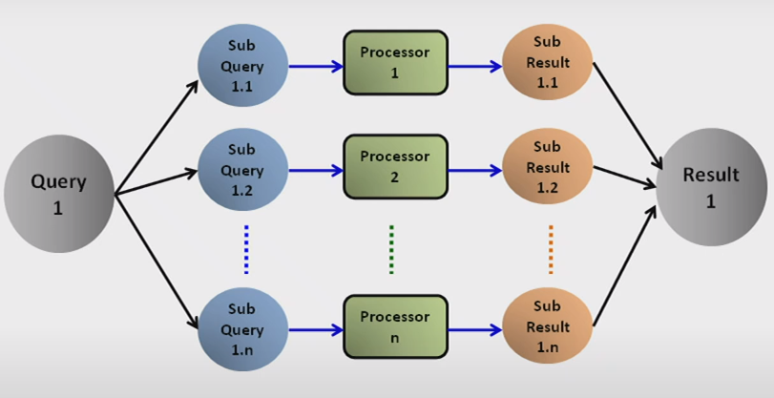
Intraquery Parallelism
“Parallelism within a query”
Execution of a single query in parallel on multiple processors and disks
Main aim: speeding up long-running queries

Slide 26
Intraquery Parallelism
Execution of a single query can be parallelized in two ways:
Intraoperation Parallelism | Interoperation Parallelism
each individual operation in the query is parallelized | Different operations in a query expressions are executed in parallel.
Example : parallel sort, parallel search | Example : Simultaneous sort or search
A single operation sorting is parallelized | The operations sorting and searching are parallelized

Slide 27
Can you guess which kind of parallel query execution is this?

Slide 28
Answer :
Intraoperation Parallelism
In this the single operation sorting is parallelized

Slide 29
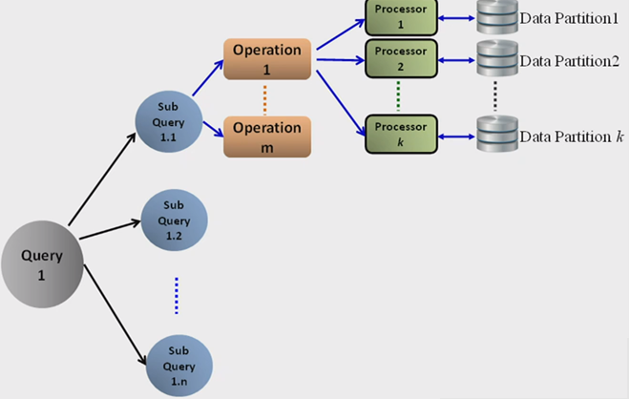
Intraoperation Parallelism
“Partitioned Parallelism”
Parallelism due to the data being partitioned
The degree of parallelism is increased based on the large number of records in a table

Slide 30
Interoperation Parallelism
Within a same query or transaction, different operations are concurrently executing.
Pipeline Parallelism | Independent Parallelism
Output record of one operation A are consumed by a second operation B without completing the first operation A. Like an assembly line, multiple operations are executing. Only useful for small number of processors. | Multiple operations in a query that do not depend on one another are executed in parallel Dose not provide a high degree of parallelism

Slide 31
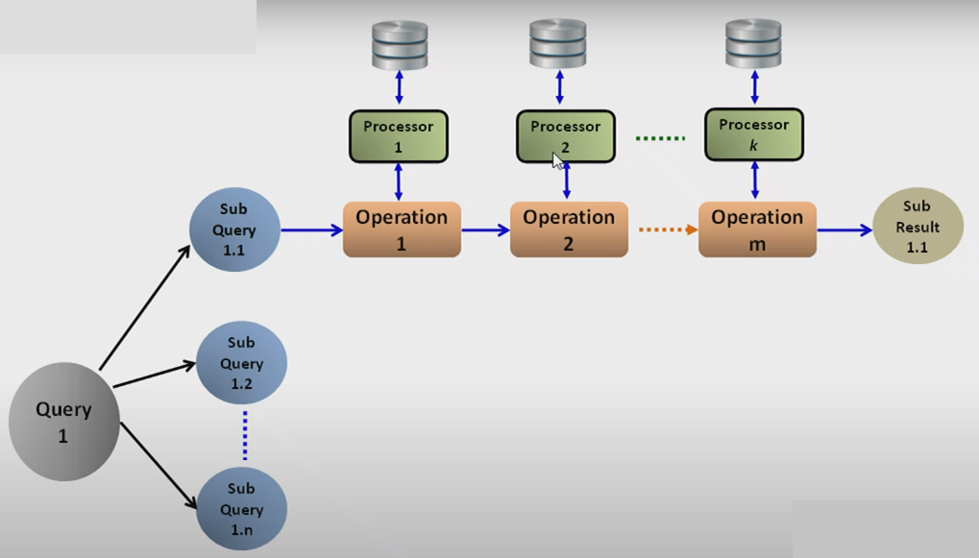
Pipeline Parallelism
Content Sources: WIT Solapur - Professional Learning Community

Slide 32
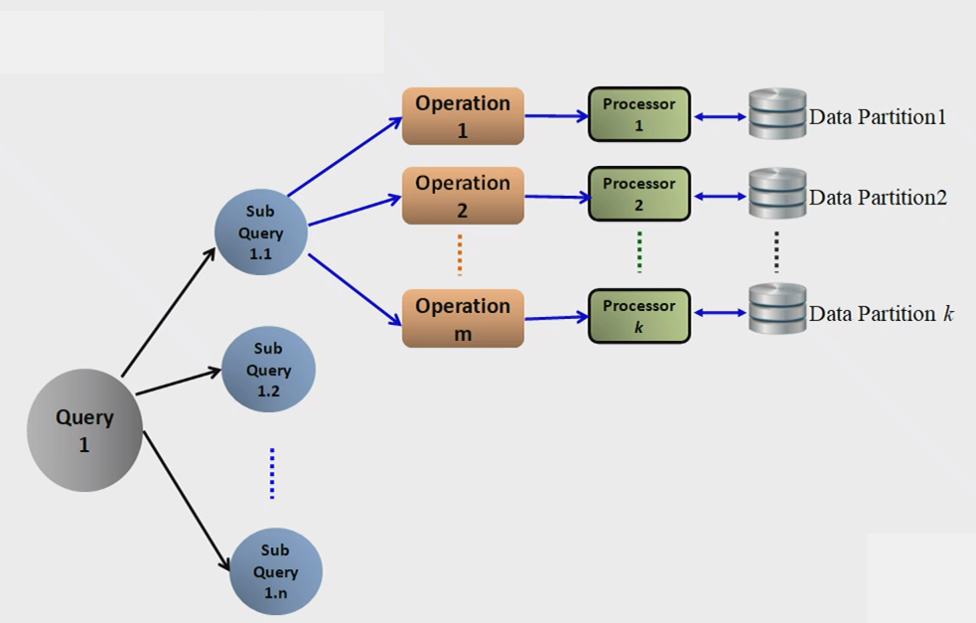
Independent Parallelism

Slide 33
Parallel Sort
Applies the Intraoperation Parallelism
An operation sort in a query is executed in parallel
Sorting Techniques for Parallelism
Range Partitioning Sort
External Sort-Merge

Slide 34
Parallel Sort: Range-Partitioning Sort
Assumptions
Assume n processors, P0, P1, ………..Pn-1 and n disks D0, D1, ……………Dn-1.
Disk Di is associated with Processor Pi.
Relation R is partitioned into R0, R1,……Rn-1 using Round-robin technique or hash Partitioning technique or Range Partitioning technique.
Objective
Our objective is to sort a relation (table) R that resides on n disks on an attribute A in parallel

Slide 35
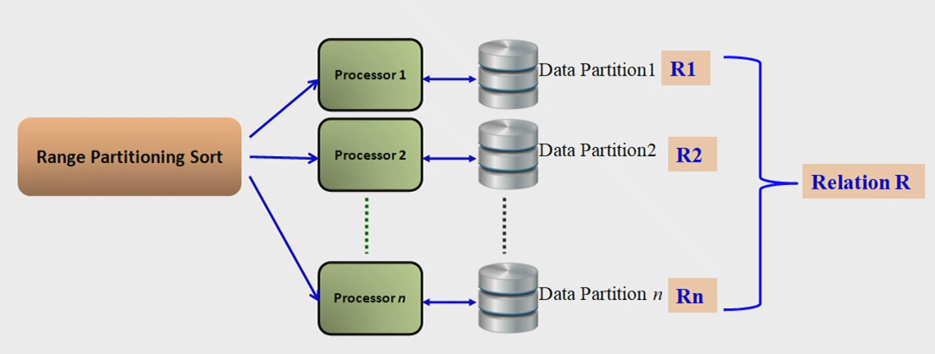
Content Sources: WIT Solapur - Professional Learning Community

Slide 36
Range-Partitioning Sort
Step 1 : Partition the relation R on the sorting attribute A at every
processor using a range vector V.
Send the partitioned records which fall in the i^{th} range to
Processor Pi where they are temporarily stored in Di.
Step2 : Sort each partition locally at each processor Pi in parallel Merge
the sorted results.

Slide 37
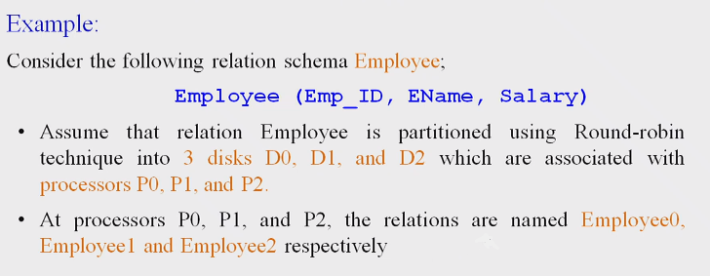
Example

Slide 38
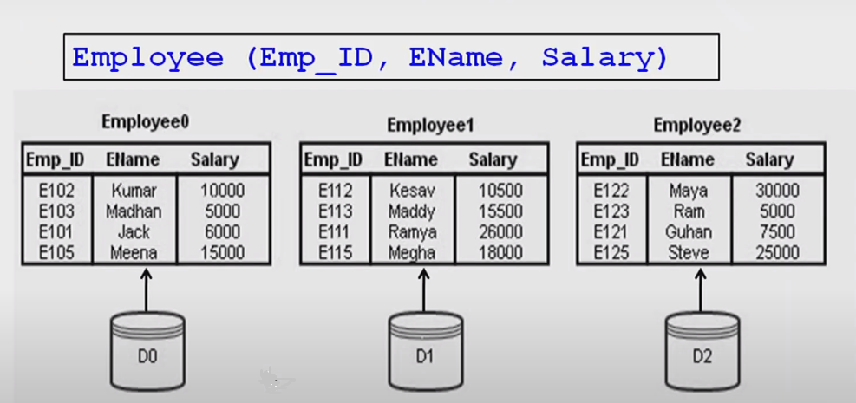
Initial Database Scenario
Content Sources: WIT Solapur - Professional Learning Community

Slide 39
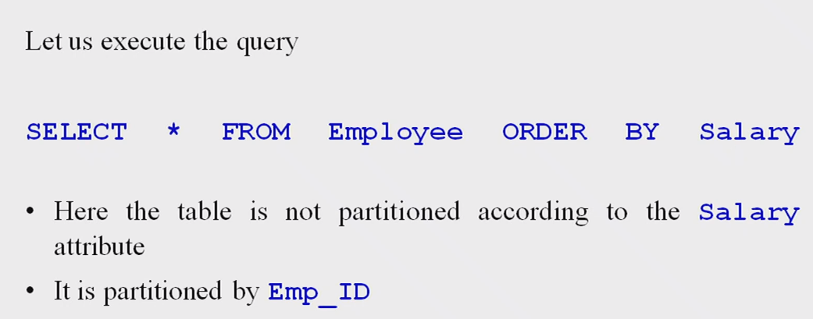
Query Execution on a relation Employee

Slide 40
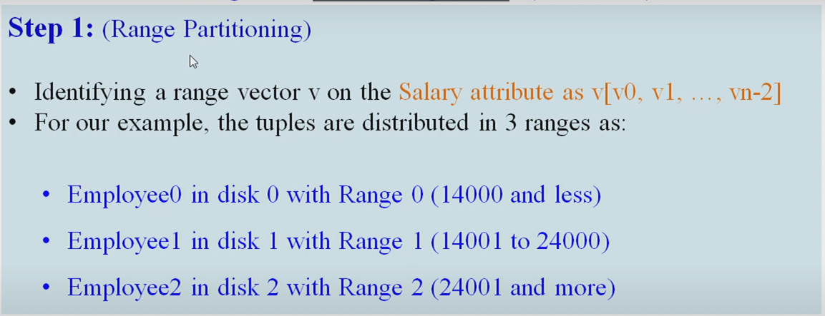
Range-Partitioning Sort steps
Content Sources: WIT Solapur - Professional Learning Community

Slide 41
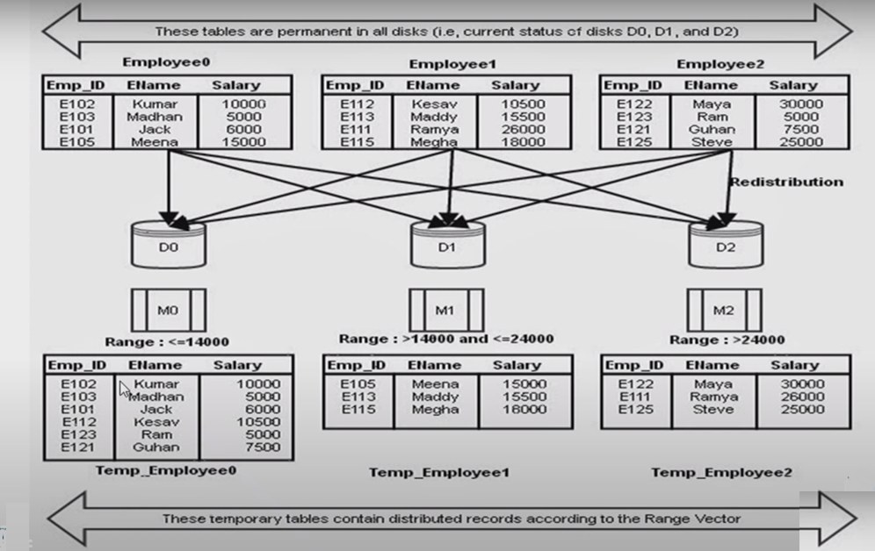
Content Sources: WIT Solapur - Professional Learning Community

Slide 42
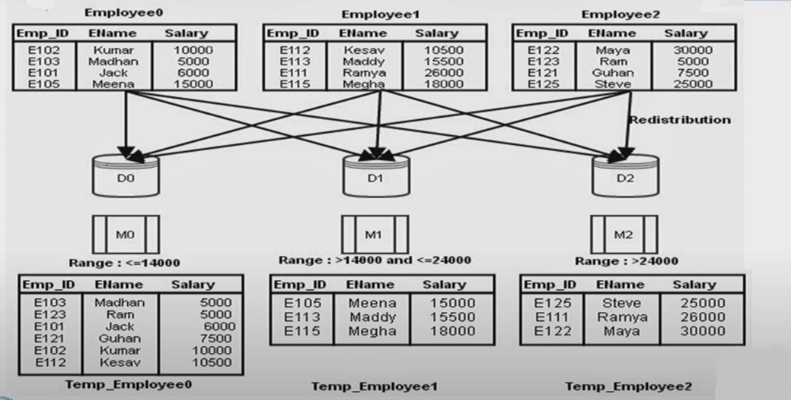
Content Sources: WIT Solapur - Professional Learning Community

Slide 43
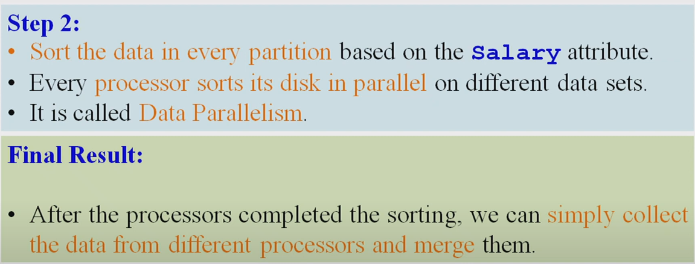

Slide 44
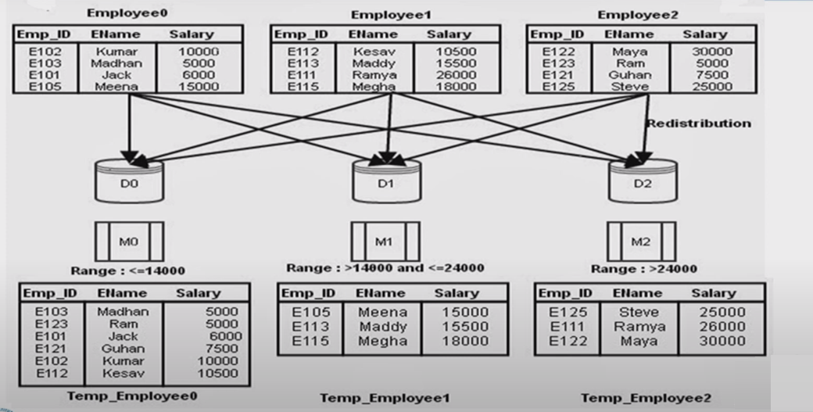

Slide 45
Parallel Sort
Applies the Intraoperation Parallelism
An operation sort in a query is executed in parallel
Sorting Techniques for Parallelism
Range Partitioning Sort
External Sort-Merge

Slide 46
Parallel External Sort-Merge
Assumptions
Assume n processors, P0, P1, ………..Pn-1 and n disks D0, D1, ……………Dn-1.
Disk Di is associated with Processor Pi.
Relation R is partitioned into R0, R1,……Rn-1 using Round-robin technique or hash Partitioning technique or Range Partitioning technique.
Objective
Our objective is to sort a relation (table) R that resides on n disks on an attribute A in parallel

Slide 47
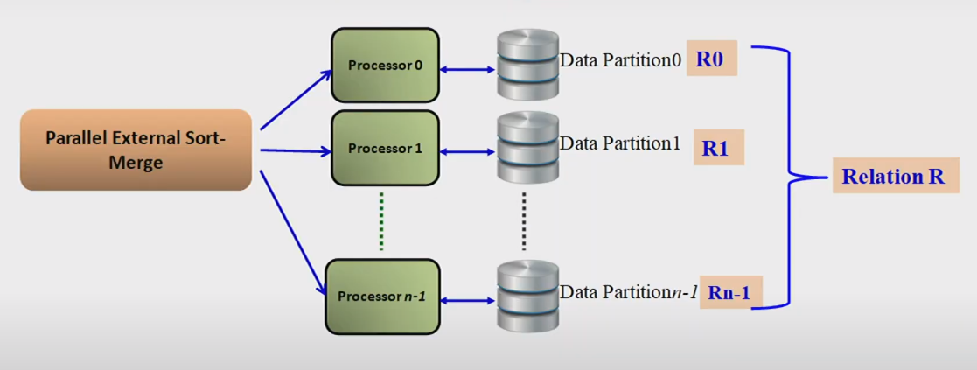

Slide 48
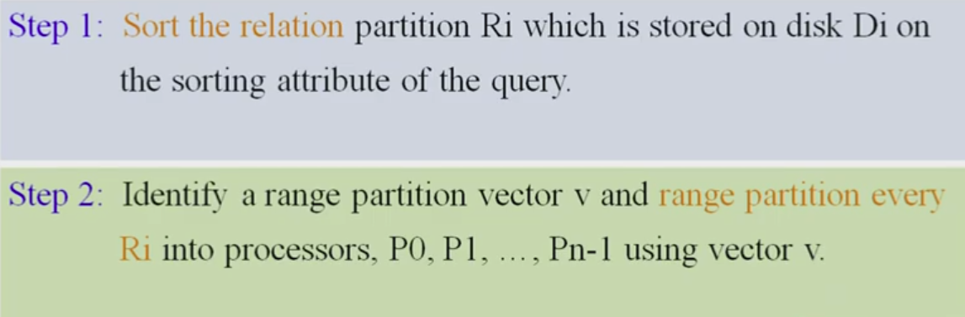
Parallel External Sort-Merge Steps

Slide 49
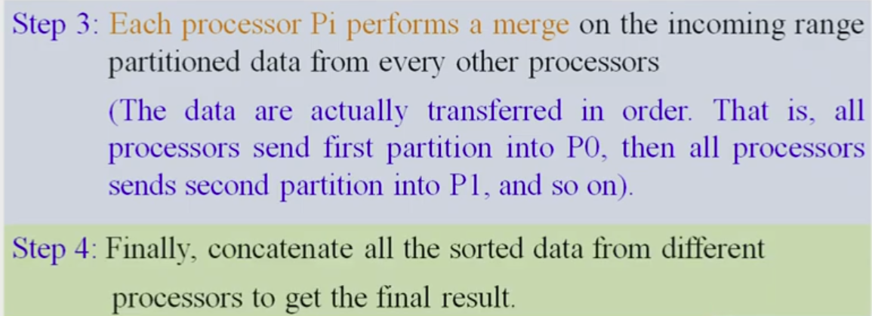
Parallel External Sort-Merge Steps

Slide 50
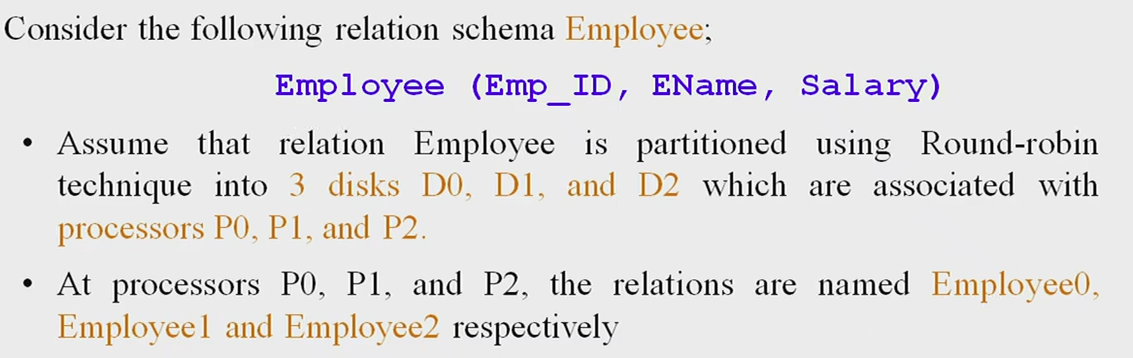
Example

Slide 51
Initial Database Scenario

Slide 52
Query Execution on a relation Employee

Slide 53
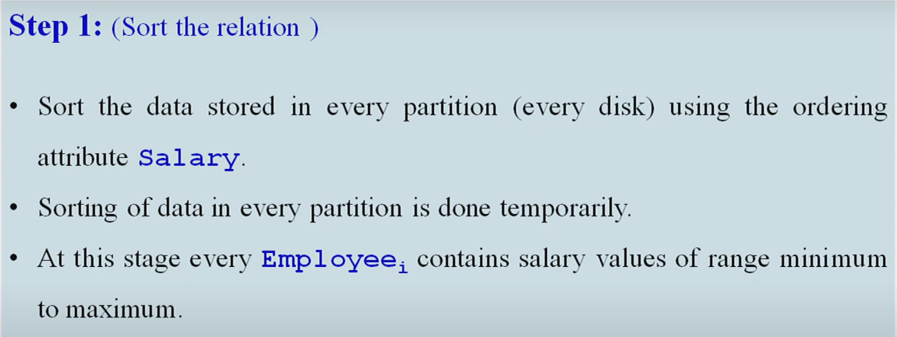

Slide 54
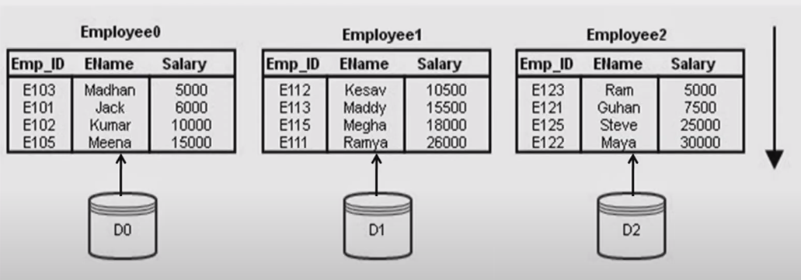

Slide 55
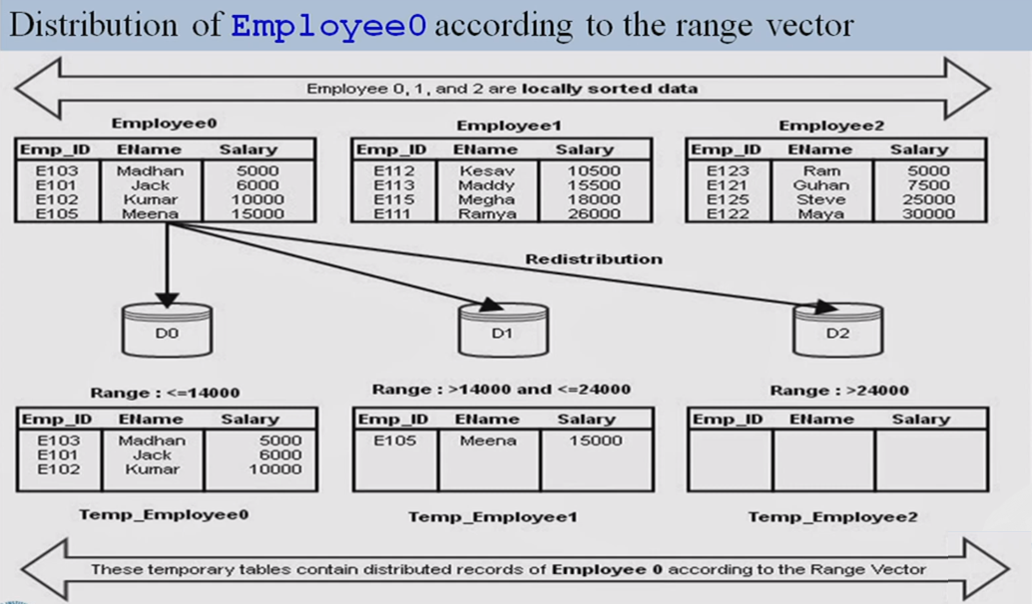

Slide 56
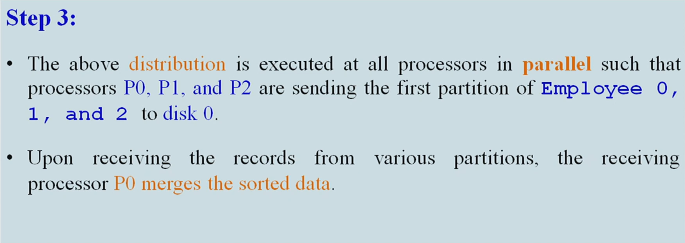

Slide 57
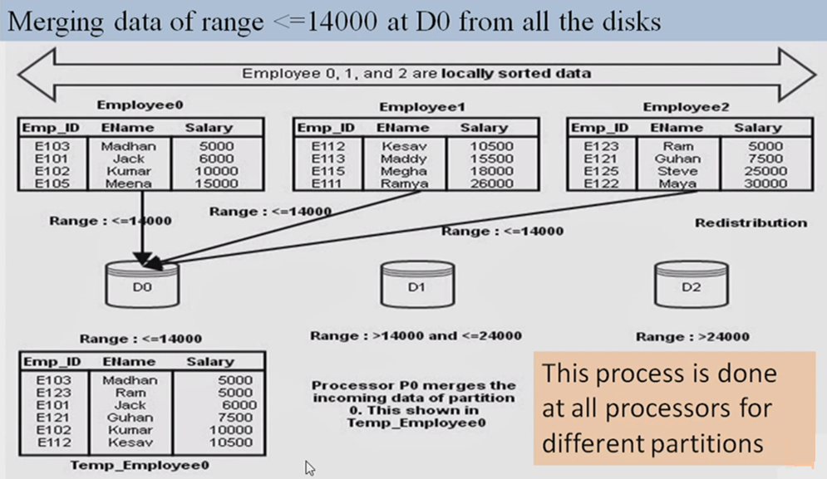

Slide 58
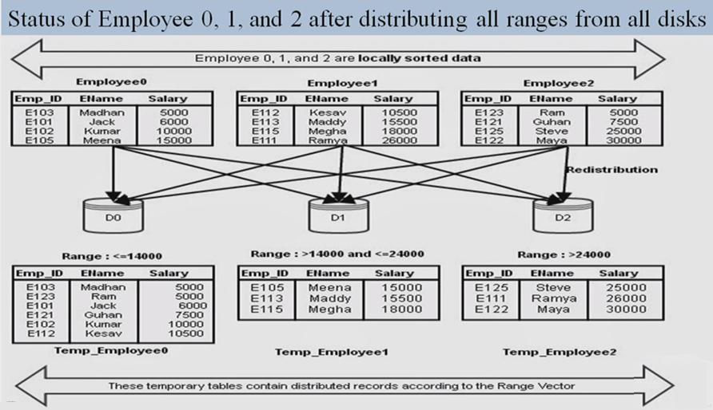

Slide 59
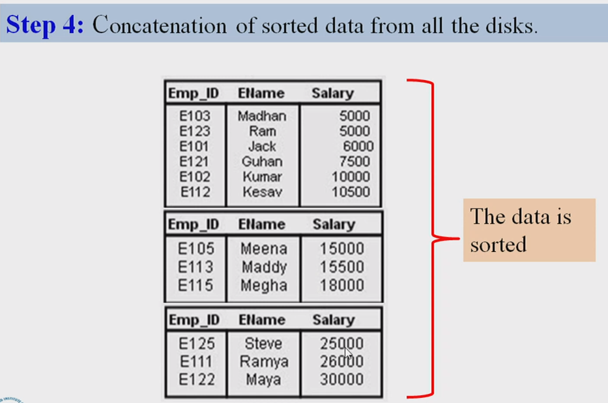

Slide 60
Partitioned Join operation in parallel databases
Intraoperation Parallelism
Each individual operation in a query is parallelized
Example parallel sort, parallel search, parallel Join
A single operation Join is parallelized

Slide 61
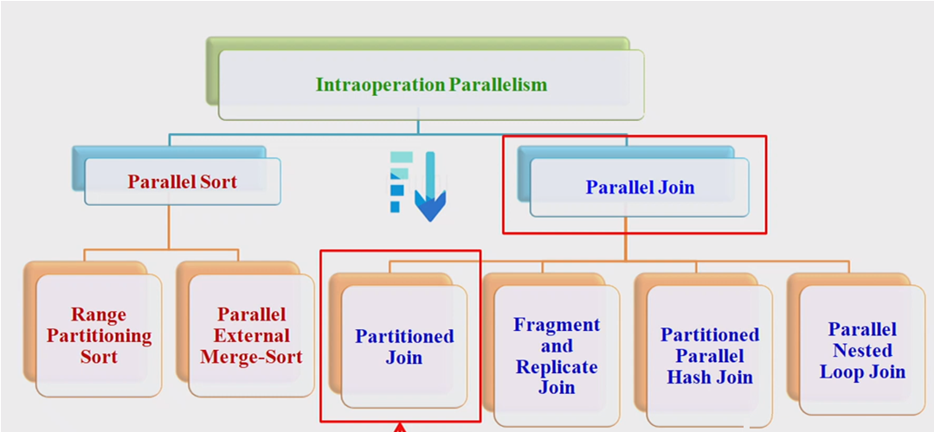

Slide 62
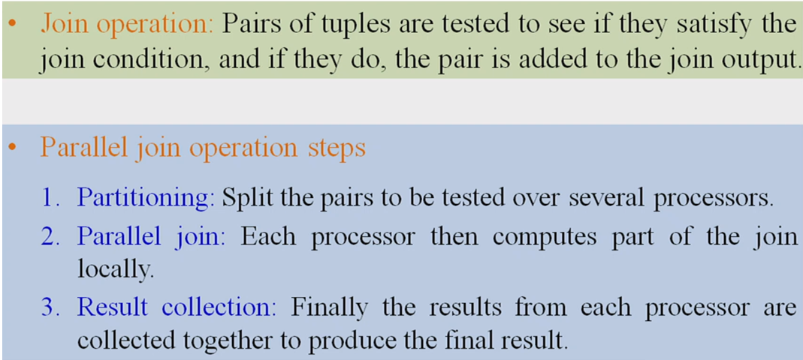
Parallel Join

Slide 63
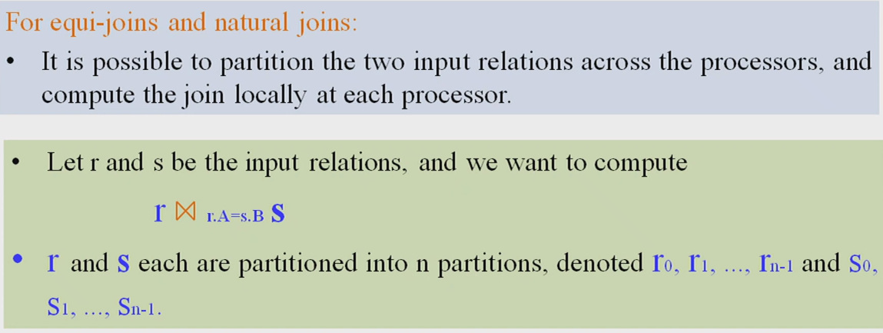
Partitioned Join

Slide 64
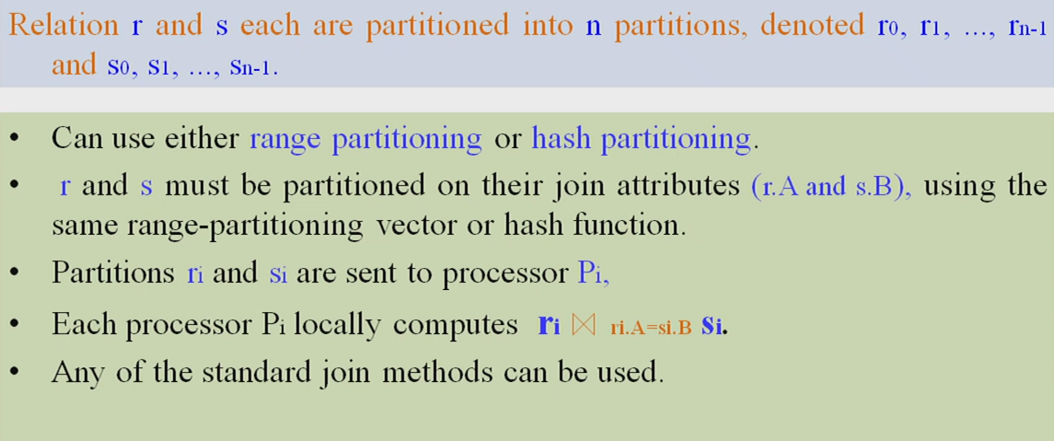
Partitioned Join

Slide 65
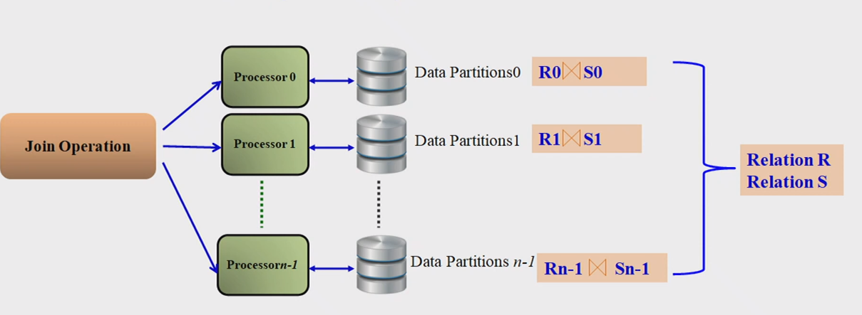
Partitioned Join
Content Sources: WIT Solapur - Professional Learning Community

Slide 66
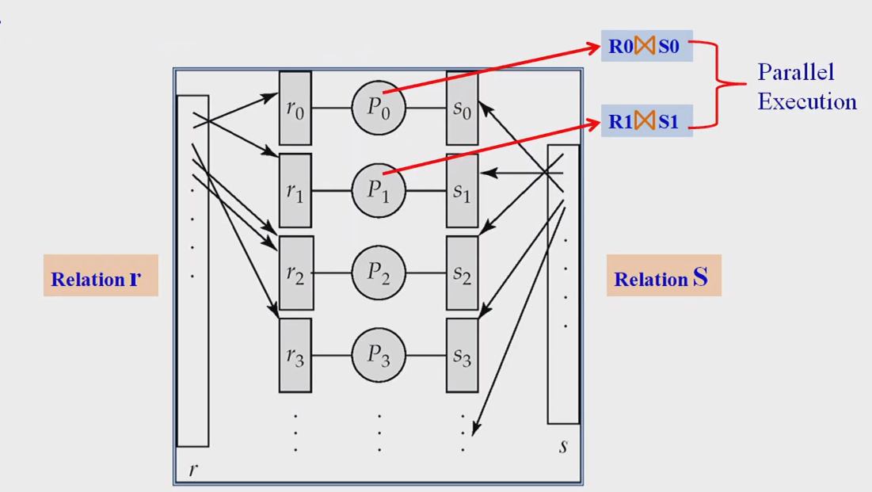
Partitioned Join

Slide 67
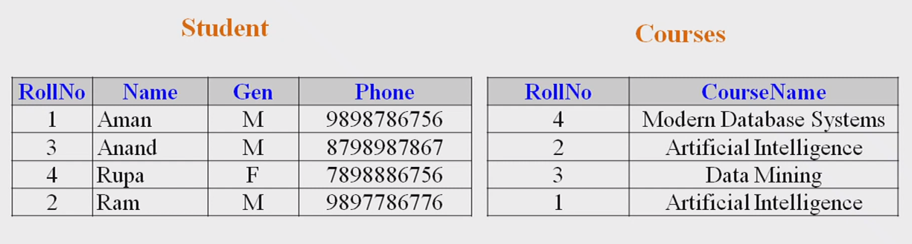
Example : Partitioned Join

Slide 68
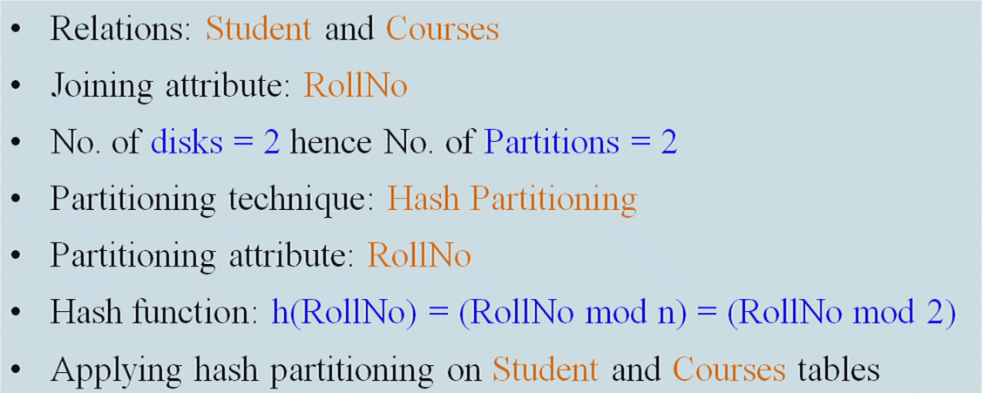
Example

Slide 69
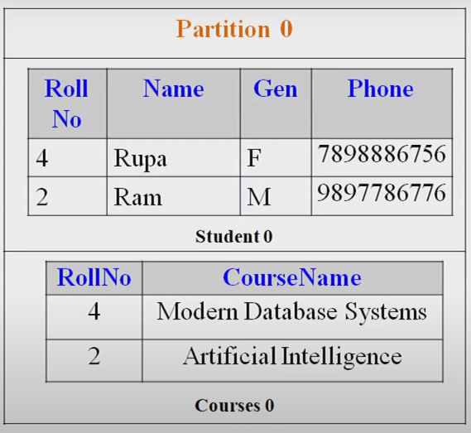
1. Partitioning
Partitioned Table
No. of Partitions: 2
Partitioning Technique: Hash Partitioning

Slide 70
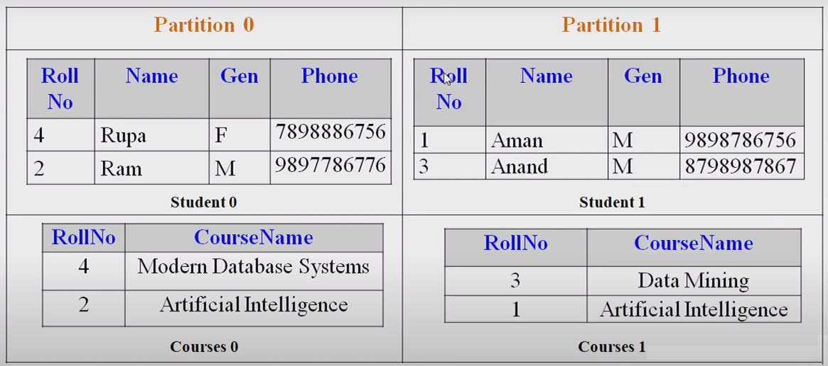
1. Partitioning
Partitioned Table : No. of Partitions: 2 , Partitioning Technique: Hash Partitioning

Slide 71
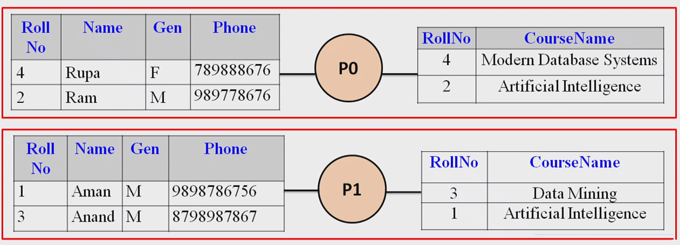
2. Parallel Join

Slide 72
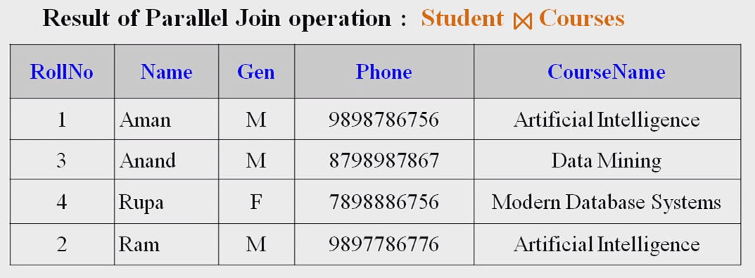
3. Result

Slide 73
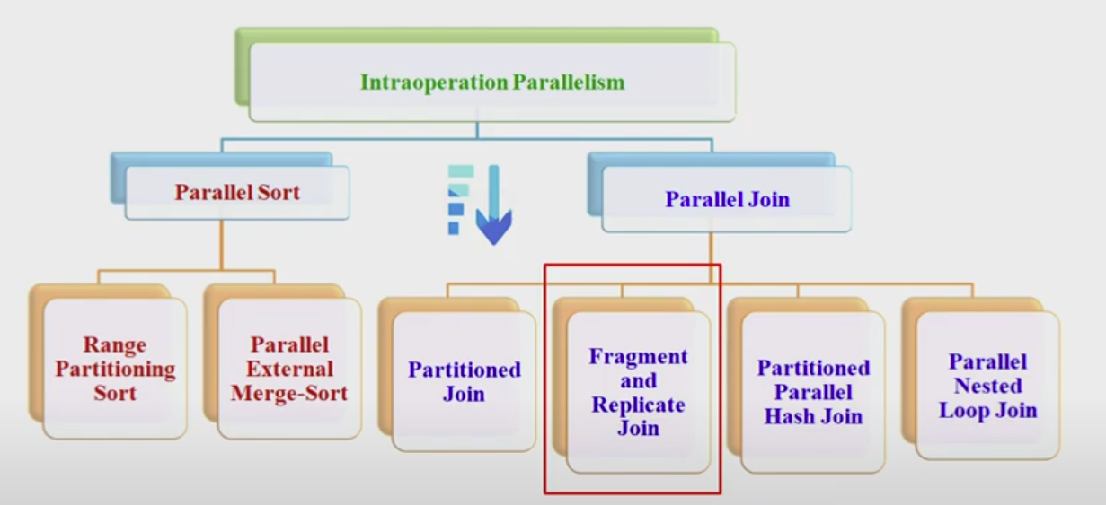
Fragment-and-Replicate Join

Slide 74
Fragment-and-Replicate Join
Partitioning not possible for some join conditions
E.g., non-equijoin conditions, such as r.A > s.B.
Condition is established using all comparison operators
except the equal (=) operator Like !=, >=, <=, <>

Slide 75

Fragment-and-Replicate Join
Example query:
For joins were partitioning is not applicable, parallelization can be accomplished by fragment and replicate technique

Slide 76
Special case – asymmetric fragment-and-replicate:
One of the relations, say r, is partitioned;
any partitioning technique can be used.
The other relation, s, is replicated across all the processors.
Processor P_{i} then locally computes the join of r_{i} with all of s using any join technique.

Slide 77
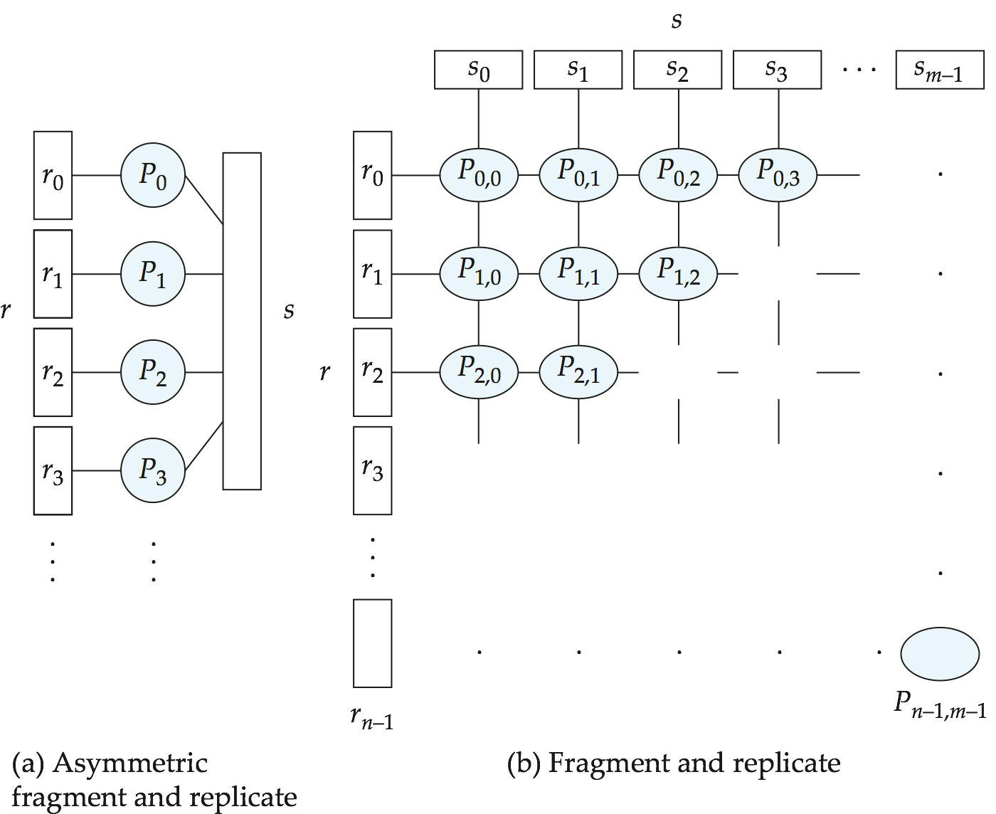
Depiction of Fragment-and-Replicate Joins

Slide 78
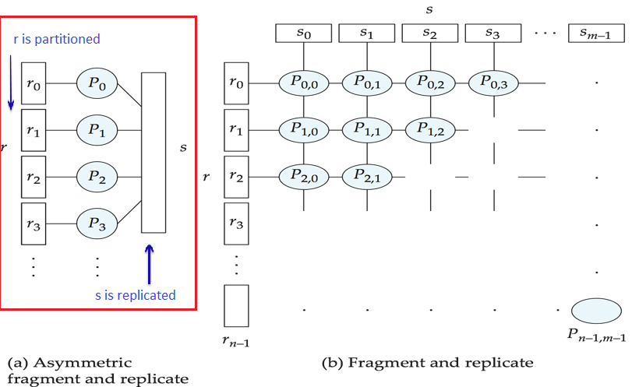
Depiction of Fragment-and-Replicate Joins

Slide 79
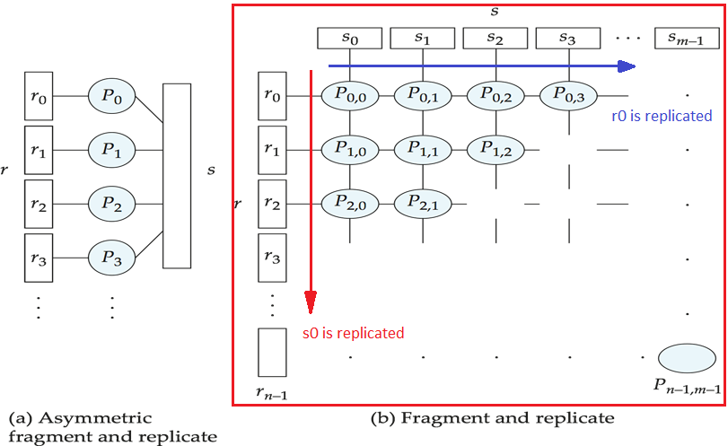
Depiction of Fragment-and-Replicate Joins

Slide 80
Fragment-and-Replicate Join (Cont.)
General case: reduces the sizes of the relations at each processor.
r is partitioned into n partitions, r₀, r₁, ..., r _{n-1};
s is partitioned into m partitions, s₀, s₁, ..., s_{m-1}.
Any partitioning technique may be used.
There must be at least m * n processors.
Label the processors as P_{0,0}, P_{0,1}, ..., P_{0,m-1}, P_{1,0}, ..., P_{n-1m-1}.
P_{i,j} computes the join of r_{i} with s_{j}. In order to do so, r_{i} is replicated to P_{i,0}, P_{i,1}, ..., P_{i,m-1}, while s_{i} is replicated to P_{0,i}, P_{1,i}, ..., P_{n-1,i}
Any join technique can be used at each processor P_{i,j}.

Slide 81
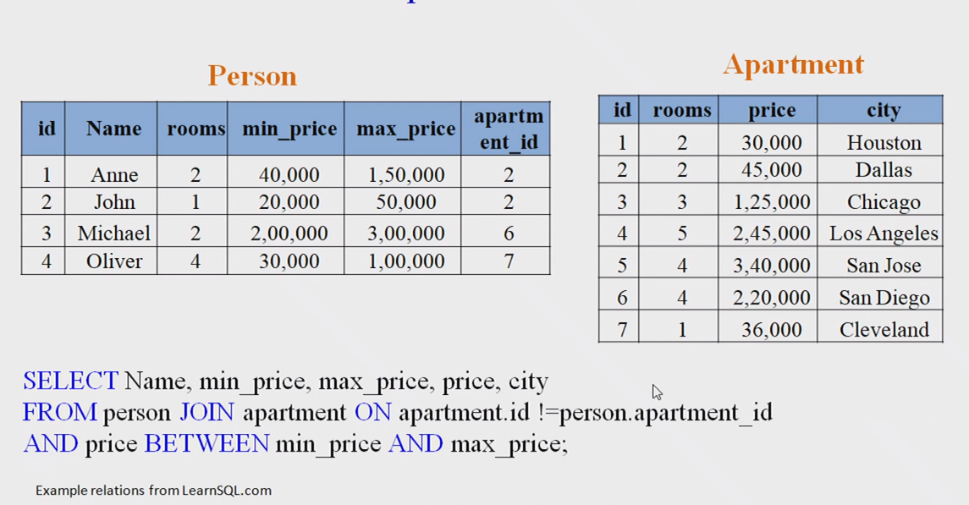
Example Relation

Slide 82


Slide 83


Slide 84


Slide 85
Fragment-and-Replicate Join (Cont.)
Both versions of fragment-and-replicate work with any join condition, since every tuple in r can be tested with every tuple in s.
Usually has a higher cost than partitioning, since one of the relations (for asymmetric fragment-and-replicate) or both relations (for general fragment-and-replicate) have to be replicated.
Sometimes asymmetric fragment-and-replicate is preferable even though partitioning could be used.
E.g., say s is small and r is large, and already partitioned. It may be cheaper to replicate s across all processors, rather than repartition r and s on the join attributes.

Slide 86


Slide 87

Partitioned Parallel Hash-Join

Slide 88
Partitioned Parallel Hash-Join
Assume we have:
N processor P₀, P₁..., P_{n-1}
Two tables r and s join operation (r and s already partitioned into disk of n
processors).
Assume s in smaller than r and therefore s in chosen as the build relation
Hash function h₁ and h₂ are used

Slide 89

Partitioned Parallel Hash-Join

Slide 90

Partitioned Parallel Hash-Join

Slide 91


Slide 92


Slide 93


Slide 94


Slide 95

Partitioned Parallel Hash-Join

Slide 96

Parallel Nested-Loop Join

Slide 97

Parallel Nested-Loop Join

Slide 98


Slide 99


Slide 100
Thankyou

